Slide 1
PEELING THE AGILE ONION
Notes:
My name is Rob Moffat. I am a Java and Javascript software developer working in London. I am building Deutsche Bank’s Symphony Practice. If you don't know, Symphony is a messaging platform that a lot of the banks use for secure, encrypted chat. The chances are that some of you are probably familiar with that in your jobs.
So I guess before I start properly,I want to give some background about why I’m doing this presentation.
I started at DB in April, and I saw that there was this “Agile Month” going on and they were looking for speakers. And I was working on a presentation to give for the London Java Group about Agile and I thought, I should just try out my presentation here. So, I signed up to give this...
But actually, that turned out to be a terrible idea. Looking at it, that presentation really wasn’t going to be completely suitable here, and so what I’ve done is, I’ve kind of car-crashed that presentation, and out of the wreckage, put together something a bit different, which I hope will be a bit more relevant here.
We’ll see.
So, the reason this talk is called “Peeling The Agile Onion” is because I really want to do is get at the heart of what makes agile work.
Hopefully this won’t be an onion that makes us cry. We’ll see.

Slide 2
Personal
Industrial
Notes:
So, what am I going to talk about today.
I’ve been working in banking over the last 20 years or so, and so really, I thought it would be interesting to look at couple of things:
One, I want to look at a “personal” history of agile - how it’s affected me, and what I’ve learned in those 20-odd years.
But I also want to look at the history of Agile within, really, the banking industry, and also look at where that’s going, and how we can expect it to develop.
So hopefully that will be interesting. But I’m also going to try and finish this talk in about 40 minutes because I think probably lots of you will have your own personal views on this, and I think it’d be interesting for us all to just discuss where we think things are heading next.
I want to give you time to react to what I’m saying, because this is all a personal viewpoint, and as we know, those are all flawed in some way.

Slide 3
riskfirst.org
https://github.com/risk-first
Notes:
Now, a third element to what I’m going to cover in my talk is some of the stuff from the London Java Group talk, which was an introduction to Risk First.
This is a website, which you can go and check out after the presentation. I’m going to introduce a few of the concepts from Risk-First today.
Because I really want to explore in this talk the dynamics of agile. That is, try to understand the forces that get us to where we are, and where we’re going. What’s working, and what isn’t. And Risk-First happens to be a fairly useful way to frame that, so I am going to make use of it a bit.
Also, it means I can re-use a whole bunch of the slides I’ve already written, which is handy.

Slide 4
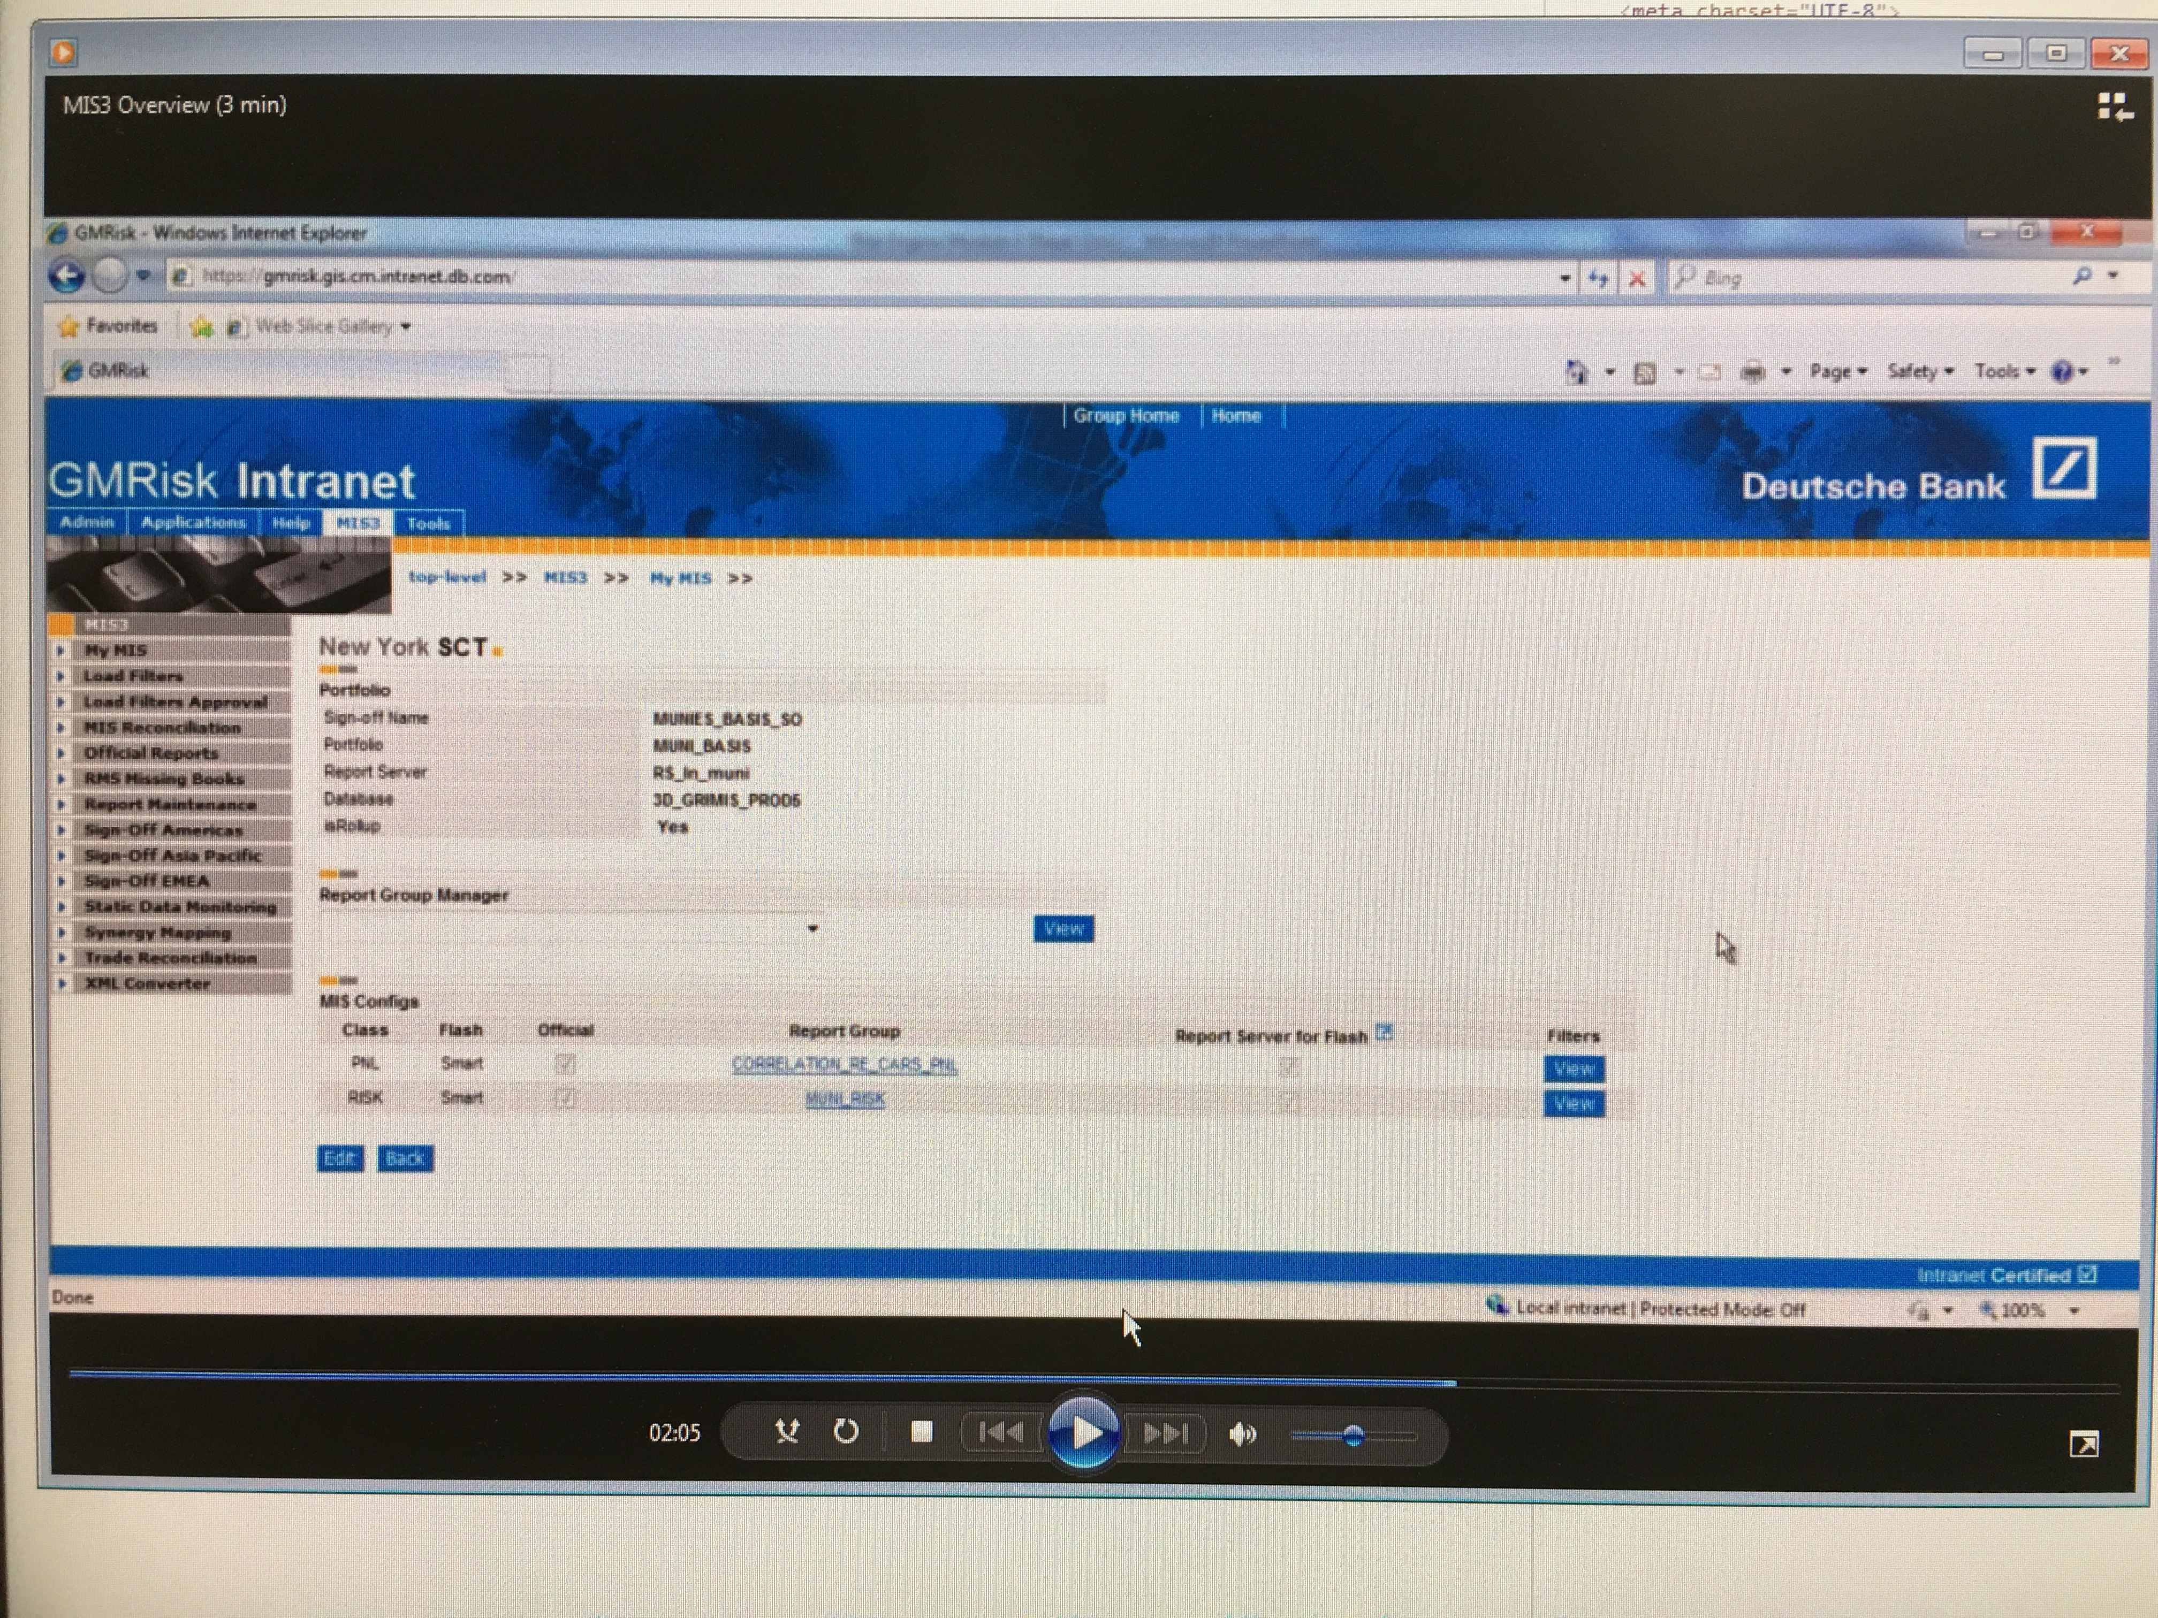
Notes:
Ok, let’s start at the start.
So, this isn’t my first time round at DB. I actually worked here from about 2002 - 2005. Which is a really long time ago.
This was one of the things I built then - it’s called MIS3, and it’s used for signing off end-of-day P&L and risk positions.
It replaced another system, which was called MIS2. So we really came up with the imaginative name there.
Now, I’m mainly showing you this because what the hell! This system is still running somewhere in the bank, and when I started in April I was able to search for this internally and have a nice trip down memory lane.
So actually DB is when I first learnt about “Agile” as a thing. MIS3 had a suite of automated tests. We released every couple of weeks. We met with our users every couple of weeks, we prioritised work.
Also, more because of when it was being done, we didn’t have a project plan, or a release date, or a signed off specification. Because back in 2002, that was just the way we rolled building banking IT! In a way, this was “Accidentally Agile”.
You could just log into production systems and change things. Root access on machines and databases. And so on. I personally managed to fry one of our production databases once.
So, actually, there was a lot of what we call “Operational Risk” back then. Individuals could either deliberately or accidentally mess things up really, really badly.

Slide 5
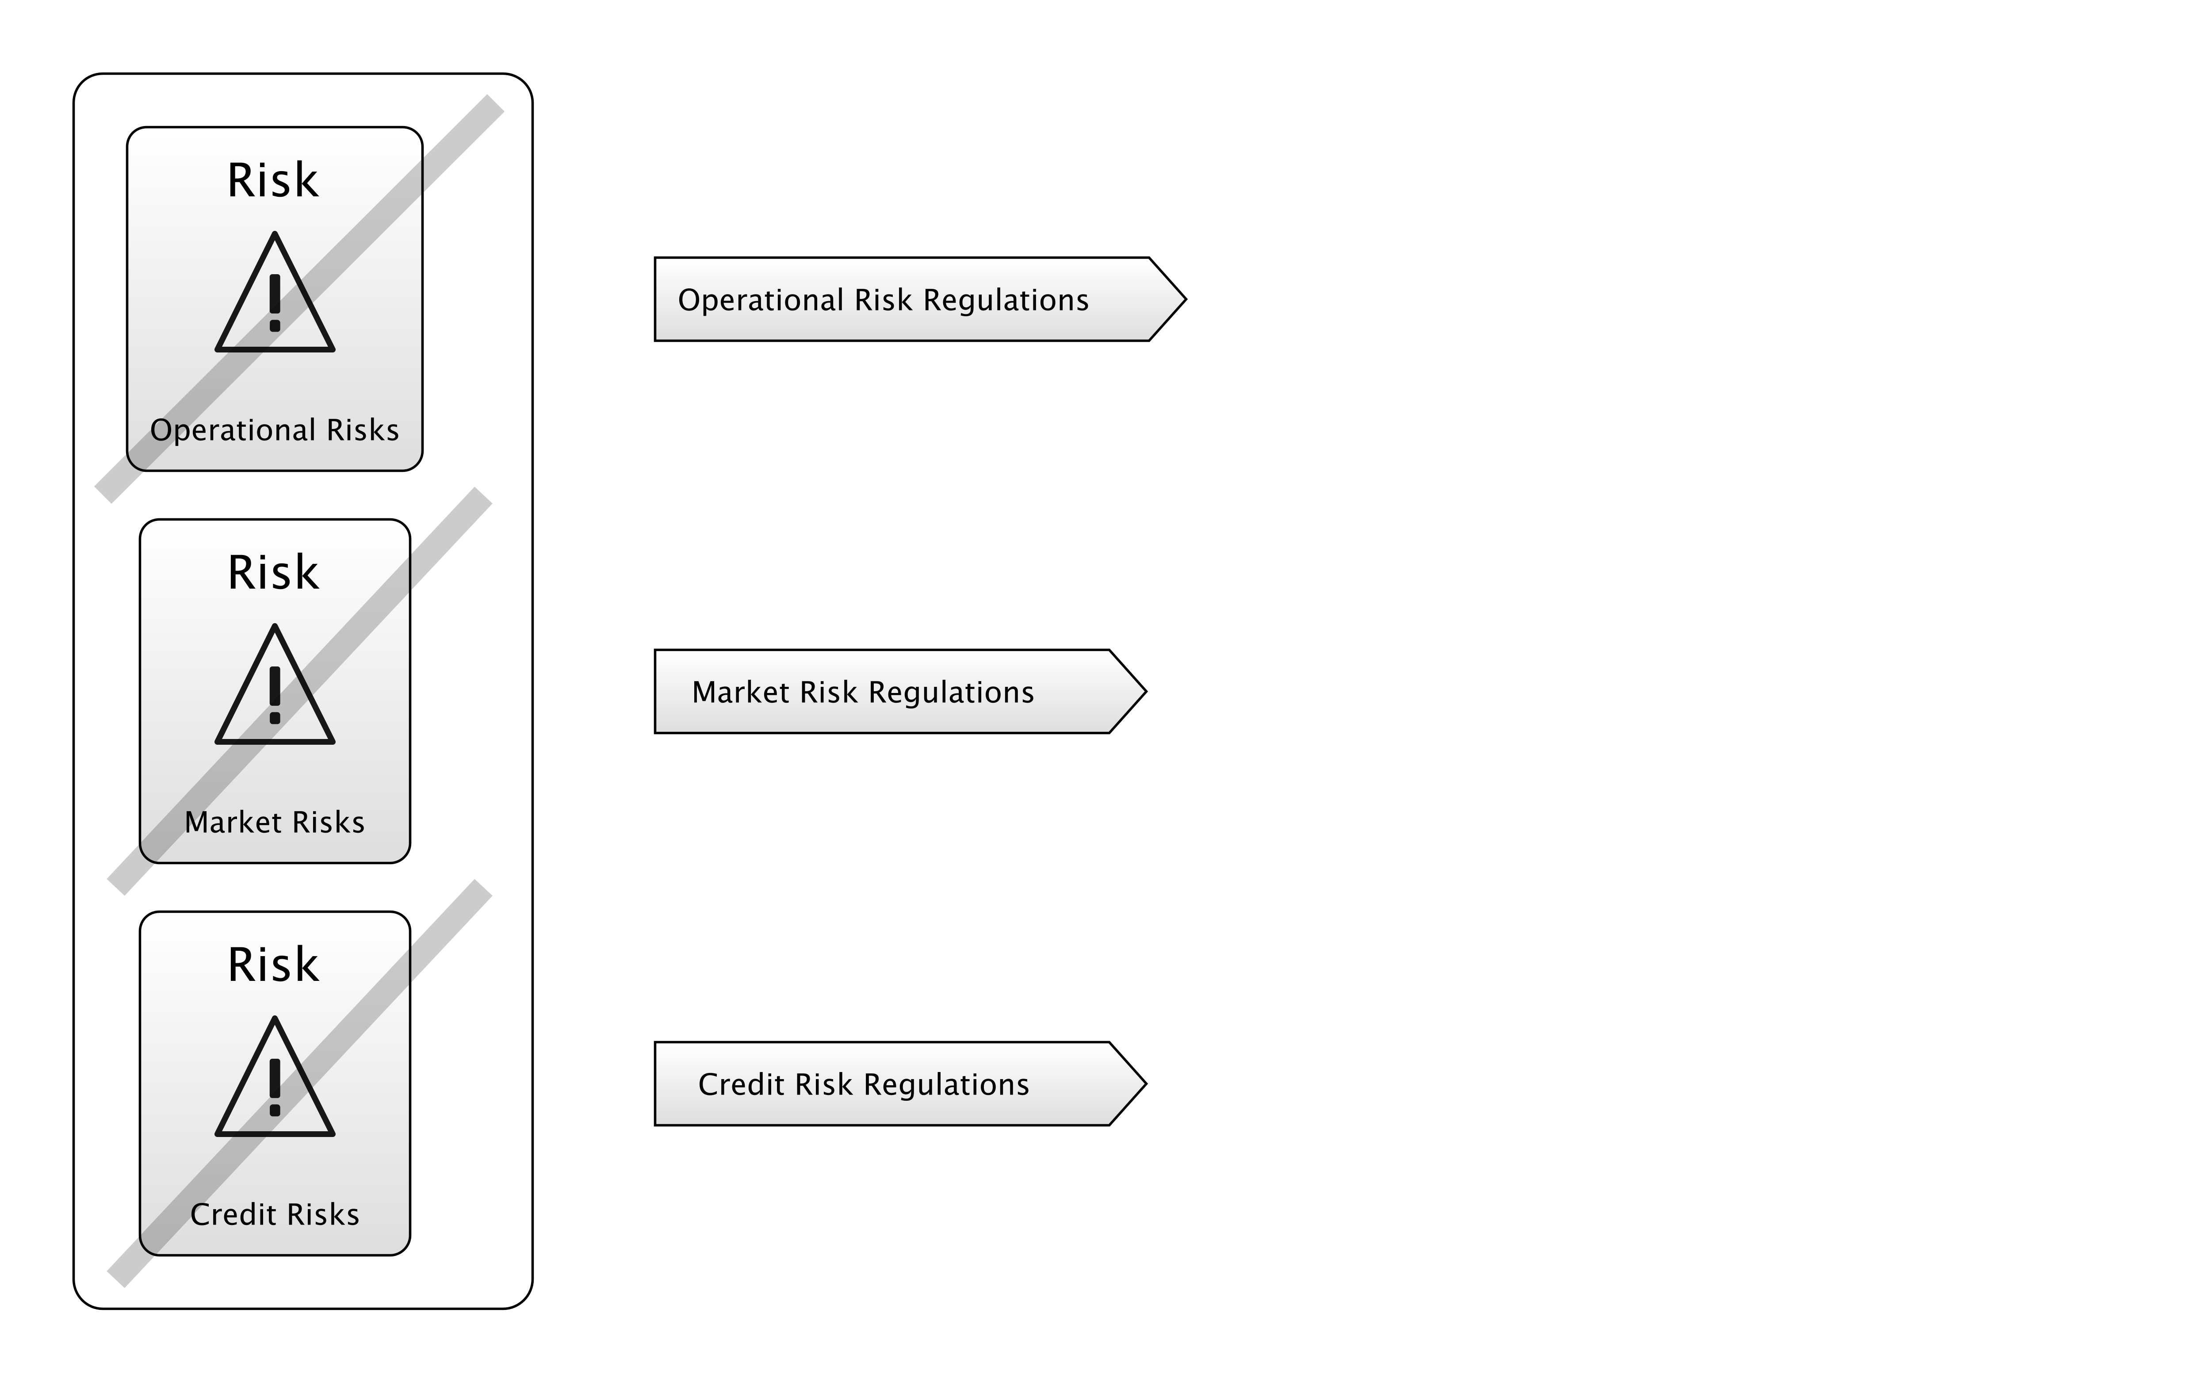
BASEL 2
Notes:
What came in in around 2005 was regulation like Basel 2 which actually addressed this Operational Risk in banks, and forced them to start doing something about it.
As you can see here in the diagram, Basel 2 addressed Operational Risks, Market Risks and Credit Risks, with new regulations for each. Basel 1 had just been about those bottom two, so Operational Risk was a new concern.
Audits started coming in, and break glass accounts, and change requests, and all this stuff.
Which made it harder to do the wrong things, but also made it harder to do the right things.
So, some of those accidentally-agile practices were going to get harder to do. For good reason. Having systems like that was just dangerous.

Slide 6
"THE BASIC PROBLEM OF SOFTWARE DEVELOPMENT IS RISK"
Notes:
Now, it turns out, bankers weren’t the only people thinking about risk.
The quote above is actually the first sentence from Chapter One of a fairly famous book on Software Development.
Does anyone know which one?

Slide 7

Notes:
Ok, who's heard of this book? Who's heard of Kent Beck?
Anyone read it?
Does anyone actually practice XP in their jobs?
This is the first Agile book I read, whilst at Deutsche Bank that first time.
This seemed like a breath of fresh air compared with what I’d learnt at university about software development.

Slide 8
Notes:
Kent had a bunch of ideas in this book, that really deviated from the accepted “norms” of software development, like Pair Programming.
This is a picture of some guys Pair Programming.
Some people love it. A lot of developers grew to hate XP because of this. They didn’t want to share a keyboard and mouse with someone, and work together.
But what is the point of Pair Programming?
What Kent is trying to avoid by enforcing this is Key Person Risk. That is, having individuals on a team who are the only people who know about a thing.
And if they leave or go on holiday, your project is down the toilet.
That’s the idea, anyway: Pair Programming is a risk-management technique. Specifically, trying to address Key Person Risk.

Slide 9
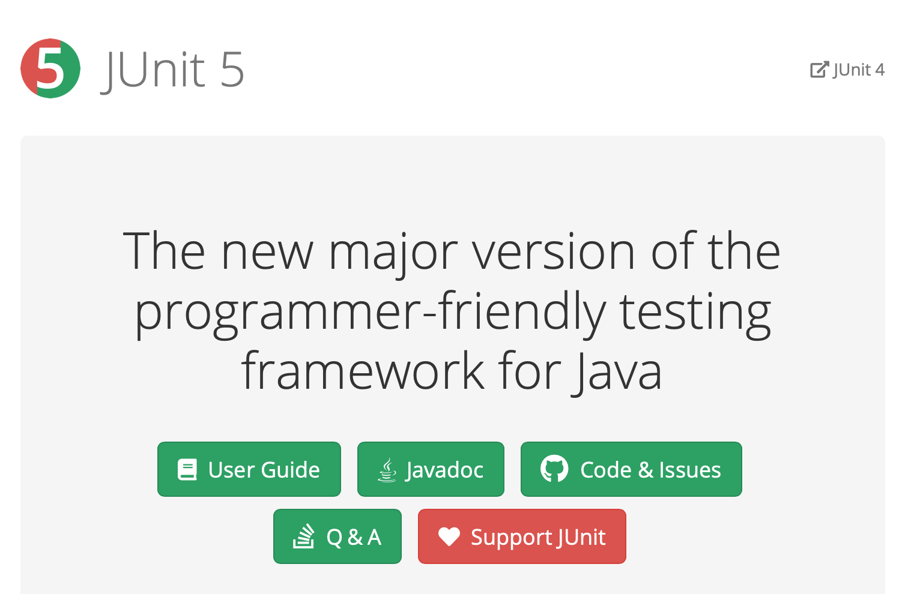
Notes:
Kent Beck also co-invented JUnit. As a Java developer, I use this all the time.
I actually can't imagine coding now without building tests as I go, and having tools to at least understand my coverage.. It just seems so helpful now to have this.
Now, why do we write tests? Why are Unit tests such an integral part of Agile?
I would say, they are managing risk.

Slide 10
Notes:
They are managing a couple of risks: First, you want to test your code before you put it in production. Putting untested code into production is an Operational Risk right there, yeah?
But also, there is a Regression Risk: our code is going to change in the future, we want to change it, and if we have tests, we have some more certainty that when we do change it, we haven’t introduced new bugs.
And, it’s a tradeoff - that’s what’s being shown here. In order to address regression risk, and operational risk, I have to own some extra code in my codebase. So, that’s complexity risk. And building those tests, and maintaining them, that’s going to take some of my schedule up, so there’s a risk to the schedule in writing tests.
Now, if you’re good at Unit Testing, this is a great deal. The trick is to write just enough tests to address the risks on the left. But if you go crazy, you end up turning it into an industry, which blows up those risks on the right.
So, it’s back to this again.

Slide 11
"THE BASIC PROBLEM OF SOFTWARE DEVELOPMENT IS RISK"
Notes:
It seems weird that Kent started his book with this statement, but what people really remember about XP is just Pair Programming, Unit Tests and eating pizza.
I think he was actually on to something really powerful right then and he didn't develop it further.
The reason is, he had these other fish to fry: he'd developed XP which, to him and many other people, was demonstrably better than the way we had been doing software development.
And so his book was just a catalog of all these "better" techniques, and how they could be used together.

Slide 12

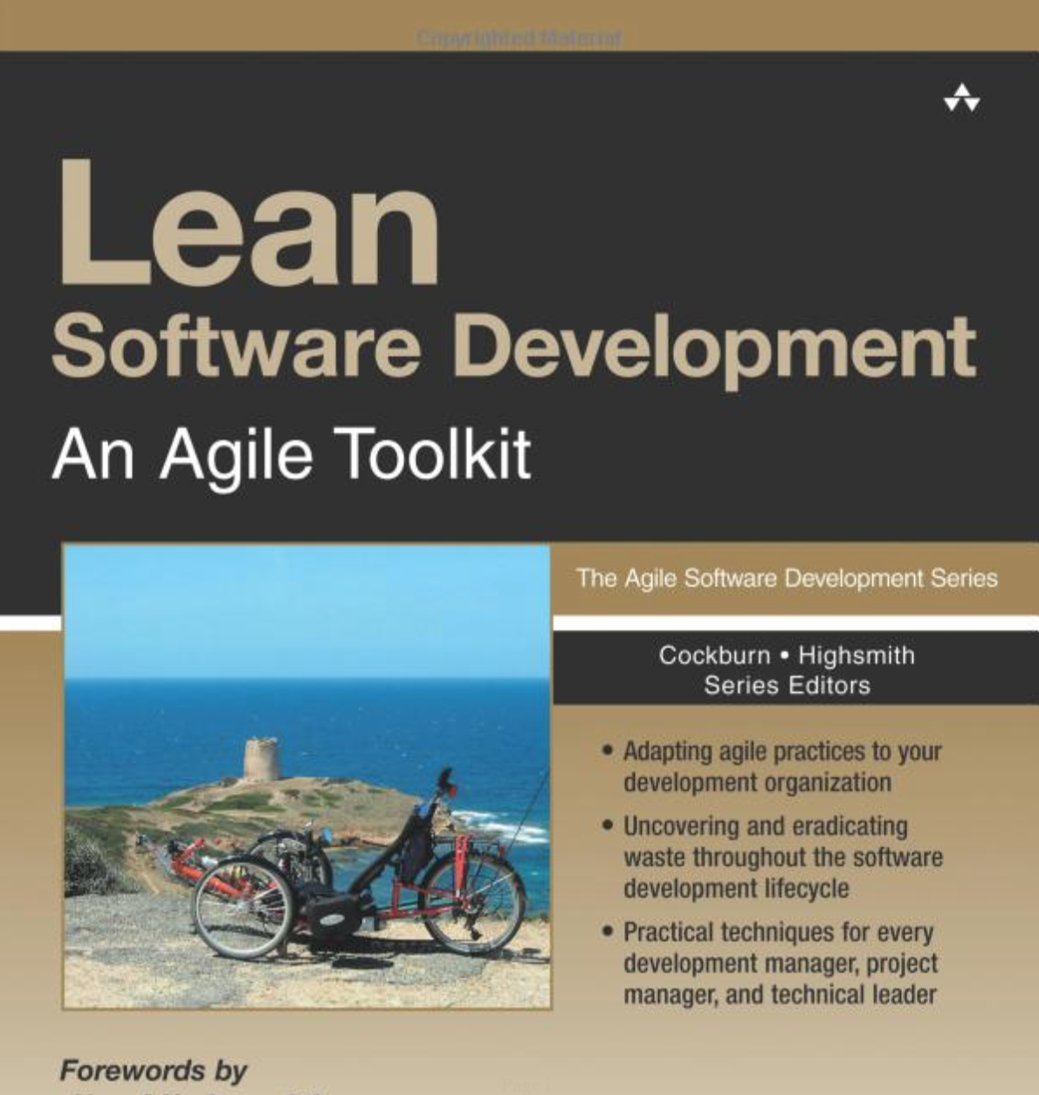
Notes:
These approaches are more popular than XP nowadays.
Who uses Scrum at work? We’re going to talk a bunch about how Scrum has been accepted in Software Development.
Anyone use Lean or Kanban?
Does anyone still use Waterfall?

Slide 13
Notes:
I’m not here to rag on Waterfall.
Sometimes, Waterfall is the right way to go!
We'll dive into that in more detail in a minute, but it feels like collectively, as an industry, or a practice, software development has been on a path of discovery.

